Slide 1
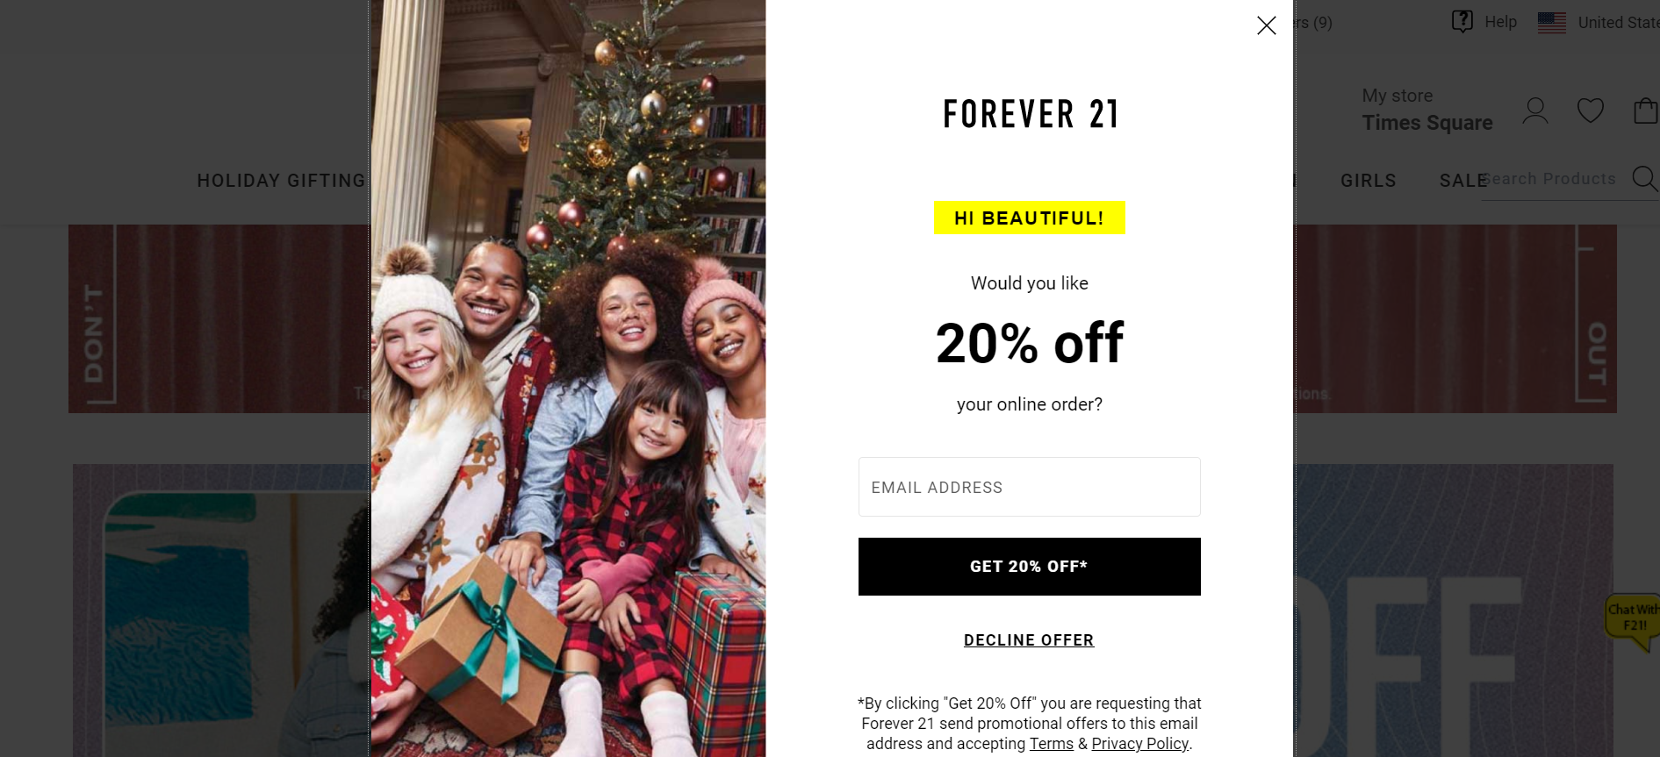
A RESEARCH
ON
POP-UPS
DESIGN
Presented by:
Shiyu Hua, Jiamin Xu, Can Luo,
Rou Gang, Guoming Shan

Slide 2
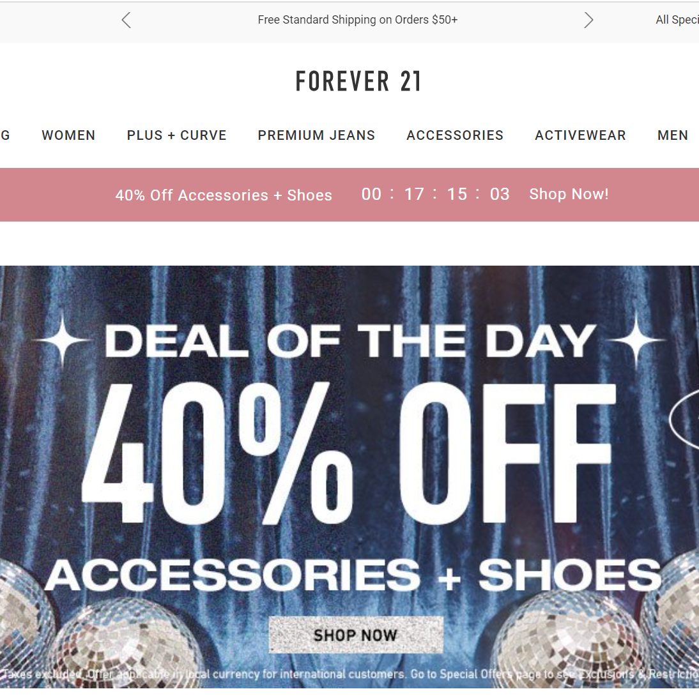
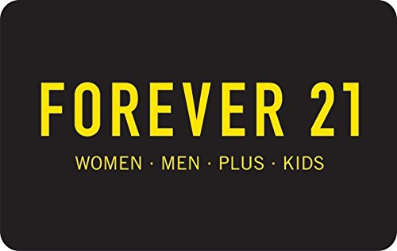
New York CNN Business —
As part of its restructuring after filing for bankruptcy last month, Forever 21 will close 200 stores, leaving the fast-fashion chain with a smaller footprint to help it emerge from Chapter 11.
Burdened by expensive store leases, unprofitable markets and continuing disruption from online shopping, the teenage clothing emporium became the latest casualty in a retail industry that is reeling from store closures and bankruptcies.
https://www.cnn.com/2019/10/29/business/forever-21-bankruptcy-store-closings/index.html

Slide 3
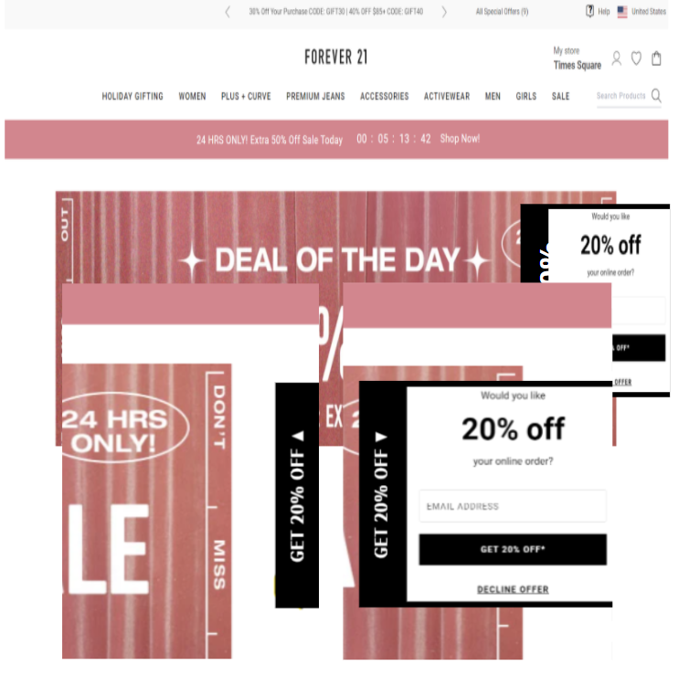

Research Questions:
Does the mean website visiting time differ between the two designs of pop-ups?
Does the mean conversion rate of subscription differ between the two designs of pop-ups?
Pop-up window is a part of the user experience (UX) design, and we want to optimize the popup design to improve user experience and increase the conversion rate of subscriptions on the website.
Non-intrusive slide-in box pop-up on the right sidebar of the website
Full-screen intrusive welcome pop-up

Slide 4

Pop-ups in widespread use, despite both positive and negative influence
Alternative non-intrusive pop-ups (e.g., in-line ads, polite pop-ups) have better positive effects than traditional intrusive pop-ups on user experience
Higher retention of website information and ad content
Catch users attention without adding negative sentiments
More willingly to interact for a relatively long time
Notes:
A “pop-up” is usually a window, that suddenly appears in the foreground of a visual interface, like a website page. Pop-ups are forms of online advertising that often contain marketing information and provide a powerful call-to-action to the customers online, and is in widespread use despite its both positive and negative influences on user experience.

Slide 5
Selecting Procedure
Population: All website visits of U.S Forever 21 official websites between March 1st and March 31 in 2022.
Sample Selection: We randomly and evenly assigned all U.S. visitors who visits forever 21 official websites during March into the control group and the treatment group
Sample Size: The team will set the sample size at 2985 for each group to ensure the accuracy of the experiment and decreasing of the uncertainty in the experiment.
Notes:
Population: all website visits of U.S. Forever 21 official websites between March 1st 2022 and March 31th 2022
We randomly and evenly assigned all U.S. visitors who visits forever 21 official websites during March into the control group and the treatment group
Sample Size:the team will set the sample size at 2985 for each group to ensure the accuracy of the experiment and decreasing of the uncertainty in the experiment.

Slide 6
Research methodology
Does the mean conversion rate of subscription differ between the two designs of pop-ups?
Does the mean website visiting time differ between the two designs of pop-ups?
one-sided t-test
one-side test of proportions
The new design pop-up will not affect visiting time
The new design pop-up will increase visiting time
The new design pop-up will not affect the conversion rate
The new design pop-up will increase the conversion rate
Notes:
There will be two tests of two outcome variables based on the research questions. For the first research questions, the team will utilize the one-sided t-test to determine whether there are differences between treatment and control groups of visited-time in a particular direction. This test will assume that the dependent variable- visited-time obeys normal distribution. The first direction is "the polite pop-up will not affect visited-time," and the treatment group will have the same visited-time as the control group has; The other direction is "the polite pop-up will have an impact on visited-time" which will cause the improvement of the treatment group.
for the second research question, the team will focus on the one-side test of proportions to compare the proportion of conversion rate in the treatment group with the proportion of conversion rate in the control group. Using the one-side test of proportions is significant to the experiment because the entire populations are enormous, and the team will use the power analysis to decide the sample size for these two tests. The first direction is "the polite pop-up will not affect the conversion rate," and the treatment group will have the same value of conversion rate as the control group. The other direction is "the polite pop-up will impact the conversion rate," and the treatment group will have a higher conversion rate than the treatment group.

Slide 7
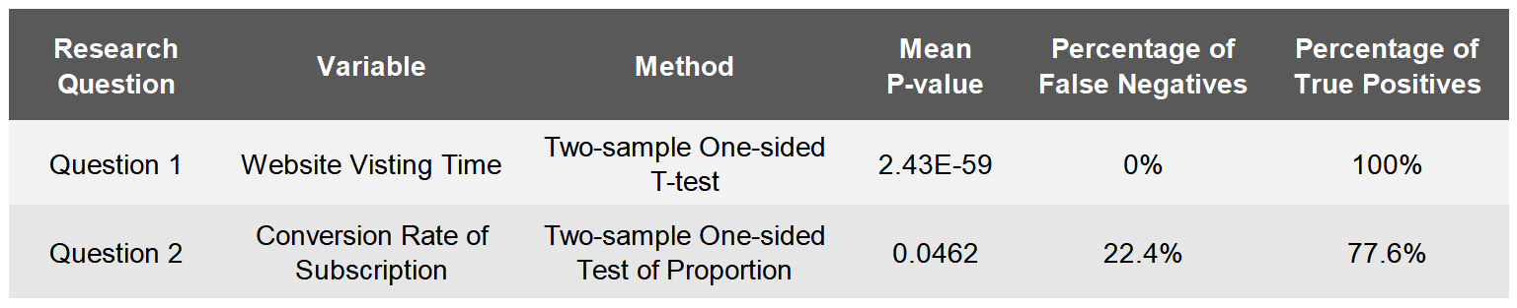
Analysis Results
Mean P-value
The new pop-up can significantly increase the website visiting time and the conversion rate of subscription.
Percentage of True Positive
The experiment is well designed with a desirable power.
Notes:
After conducting 1000 times of simulation, the results were summarized in the table.
We first focus on the mean p-values of the 1000 simulations. Both the p-value of the two research questions is less than the significance level of 0.05.
So, we can conclude that the the new pop-ups can increase the website visiting time and the conversion rate of subscription.
Then, we focus on the percentage of true positive to evaluate our experiment design.
This percentage tells the likelihood the experiment can demonstrate the effect when it exists.
For the first research question, it’s 100%.
For the second one, it’s nearly 80%.
This result is acceptable and roughly in line with our expectation.
So, we can say that our experiment has been well designed to detect a true effect for both the two research questions.

Slide 8
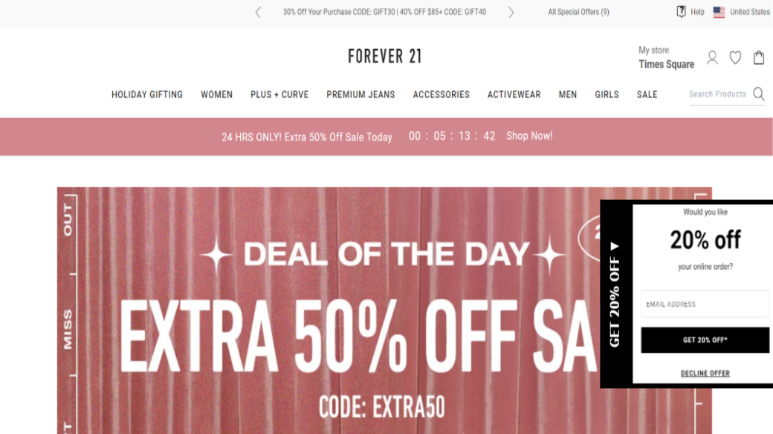
Implications
vs
A non-intrusive slide-in box pop-up is recommended.
Relieve visitors’ resistance to pop-ups
Attract visitors to spend more time on the website
Improve the likelihood of the email subscription

Slide 9


